Slide 1

Why Should the Pressure on Students Be Reduced?

Slide 2
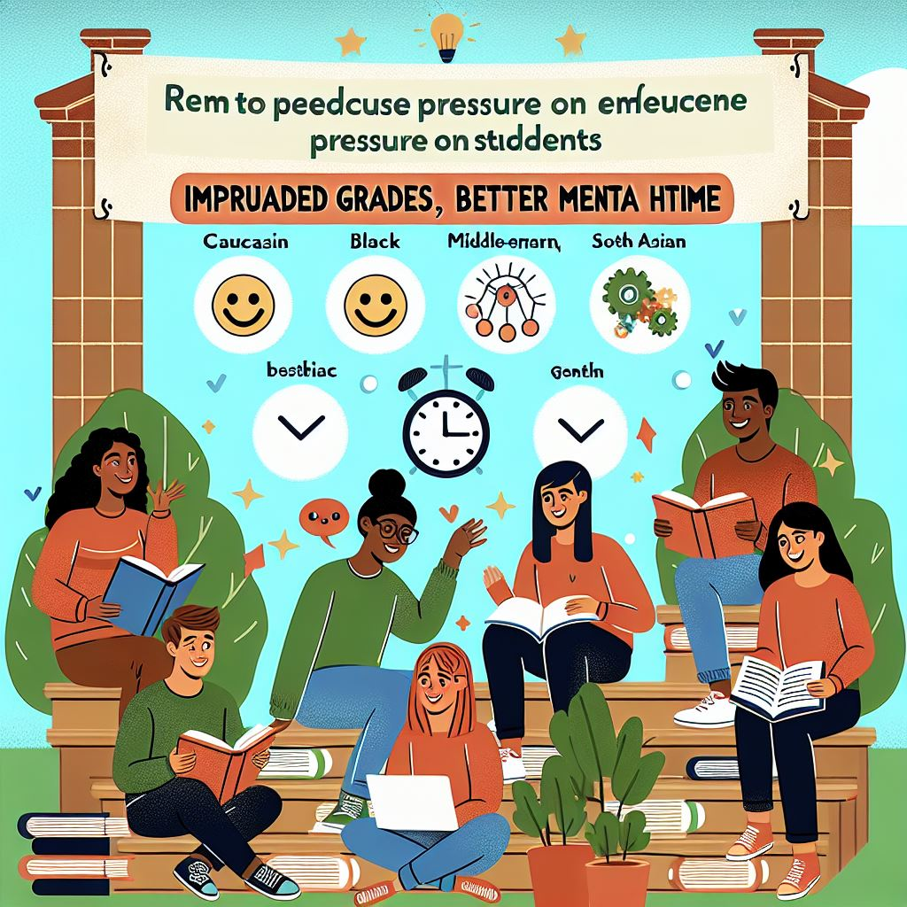
Argumentation
Reducing the Pressure on students :
Increases grades
improves mental health
It gives students free time

Slide 3
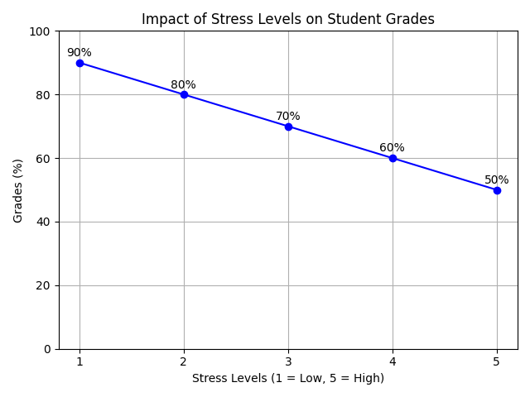
It Increases grades
49% of students felt a significant amount of stress daily, which was lower academic performance

Slide 4
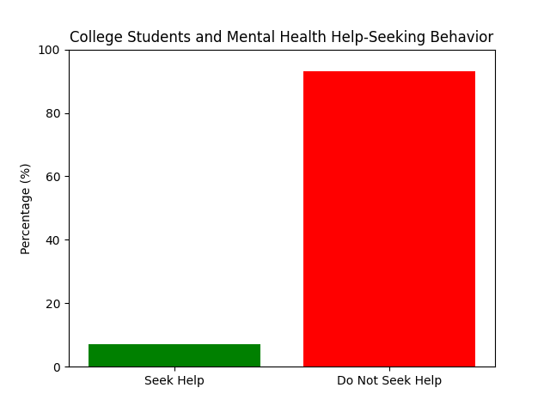
It improves mental health
Only 7% of college students ask for help from a mental health professional when they feel stressed or depressed.

Slide 5
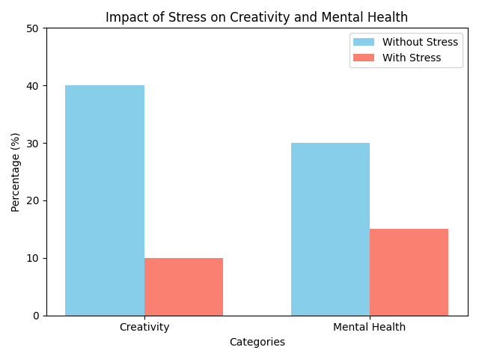
It gives students free time
This study found that students who have free time for fun activities are 40% more creative and 30% healthier mentally than those who don't have much free time.

Slide 6

Conclusion
Let’s make it happen !

